Slide 1

DEPARTMENT OF COMPUTER SCIENCE & ENGINEERING
SCHOOL OF COMPUTING
1156CS701- MAJOR PROJECT
WINTER SEMESTER 2023-2024
IN-HOUSE
SEMESTER END PROJECT VIVA VOCE EXAMINATIONS
“ENHANCING INSURANCE CLAIM INTEGRITY USING MACHINE LEARNING FOR FRAUD DETECTION AND ANALYSIS”
SUPERVISED BY
Dr. S.Lalitha
Associate Professor
PRESENTED BY
M.V.Vishnuvardhan Reddy (VTU 16707)(20UECS0603)
Y.Karun Kumar (VTU 18059)(20UECS1037)
3. Y.Ramana Reddy (VTU 16717)(20UECS1046)

Slide 2
AGENDA
ABSTRACT
OBJECTIVE
INTRODUCTION
LITERATURE REVIEW (SOFT COPY OF PAPERS TO BE LINKED AS HYPERLINK)
DESIGN AND METHODOLOGIES
STANDARDS & POLICIES USED
IMPLEMENTATION
TESTING
INPUT AND OUTPUT
INCLUDE DEMO VIDEO (You Tube URL of complete demonstration of project )
CONCLUSION
FUTURE ENHANCEMENTS
PLAGIARISM REPORT OF PPT
POSTER PRESENTATION
JOURNAL/CONFERENCE PUBLICATION PROOF(MANDATORY TO ATTACH)
GitHub Link
WEB REFERENCES LINK
REFERENCES

Slide 3
ABSTRACT
Insurance Company working as commercial enterprise from last few years have been experiencing fraud cases for all type of claims. Amount claimed by fraudulent is significantly huge that may causes serious problems, hence along with government, different organization also working to detect and reduce such activities.. These fraudulent practices undermine the integrity of insurance claim processes and necessitate the development of robust systems to address them effectively. In response to the escalating threat of insurance fraud, the aim of this project is to develop a comprehensive system capable of analyzing vast datasets of insurance claims to detect fraudulent and fake claims. Leveraging machin learning algorithms such as decision tree, support vector machine, logistic regression, naïve bayes, stochastic gradient descent algorithms, the project seeks to construct models that can accurately label and classify claims based on their fraudulent nature. The project aims to empower insurance companies with the tools necessary to proactively identify suspicious claims and mitigate potential losses.

Slide 4
OBJECTIVES
Aim of the project
The aim of the project is to use machine learning to detect and reduce fraudulent insurance claims, particularly in the auto sector, by analyzing a dataset and implementing classification algorithms.
Scope of the project
This research aims to identify what are the major determinants of fraud claims and proposed a machine learning solution for detecting fraud claims. Past claim data will be analyzed with underwriting details.

Slide 5
INTRODUCTION
Insurance fraud presents a significant challenge for insurance companies worldwide, resulting in financial losses and higher premiums. Detecting and preventing fraudulent claims is essential for industry integrity and fairness. Traditional methods rely on manual investigation and rule-based systems, limiting adaptability.
Machine learning is a powerful tool for enhancing fraud detection in insurance claims. By analyzing vast datasets, ML algorithms can identify patterns indicative of fraudulent activity. This enables insurance companies to detect fraud more effectively and proactively address complex schemes.
In this project, the application of machine learning in fraud detection and analysis for insurance claims is explored. Various ML algorithms and techniques are discussed that can be employed to detect fraudulent claims, including supervised learning and anomaly detection. Furthermore, the project delves into feature engineering, model evaluation, and deployment strategies tailored specifically to the insurance fraud detection domain.

Slide 6
LITERATURE REVIEW
[1]Adedayo, et al, (2022) focused on utilizing machine learning algorithms to predict fraud in automobile insurance claims. It presents an in-depth exploration of various machine learning techniques and their application in detecting fraudulent activities. The study aims to enhance prediction accuracy and mitigate financial risks for insurers by developing effective fraud detection models.
[2]Caruana, et al, (2022) explored various methods and technologies employed in detecting fraudulent activities within the automobile insurance sector. The authors likely discuss traditional approaches like manual checks and basic rules, as well as advanced techniques such as machine learning. They examine the challenges faced by insurance companies in detecting fraud and evaluate the effectiveness of different fraud detection strategies. Overall, the article provides valuable insights into the current landscape of automobile insurance fraud detection, offering a foundation for further research and practical application in the field.

Slide 7
LITERATURE REVIEW
[3]Elsevier , et al, (2022) investigated how artificial intelligence and machine learning can improve insurance fraud detection. It examines data to find patterns and anomalies indicating fraud in insurance claims. By comparing different AI and ML techniques, the study aims to enhance fraud detection in the insurance industry, providing valuable insights for insurers and policymakers.
[4]Jenita Mary, et al, (2022) explored the application of machine learning classifiers in detecting fraud within healthcare insurance claims. The authors investigate various classifiers and evaluate their effectiveness in identifying fraudulent activities within the healthcare insurance domain.The authors probably present insights into the effectiveness of different classifiers in detecting fraud, comparing their performance and accuracy. Through their study, they likely aim to contribute to the development of more robust fraud detection systems.

Slide 8
LITERATURE REVIEW
[5]Kapadiya, et al, (2023) explored the utilization of blockchain and artificial intelligence (AI) to enhance fraud detection in healthcare insurance. It likely provides an analysis of the current landscape of healthcare insurance fraud, highlighting the shortcomings of traditional detection methods. The authors propose an integrated architecture that combines blockchain technology for secure data storage with AI algorithms for fraud pattern analysis. The article may discuss the technical aspects of this approach and its potential benefits, such as improved accuracy and scalability.
[6]Mary Arockiam,et al, (2022) introduced an innovative approach to fraud detection in the healthcare insurance industry through the utilization of MapReduceIterative Support Vector Machine (SVM) classifiers. The study presents a novel system that merges the scalability of MapReduce with the precision of SVM classifiers to efficiently identify fraudulent activities in healthcare insurance claims. By incorporating advanced data processing techniques and machine learning algorithms, the proposed system aims to enhance fraud detection accuracy, thereby bolstering the effectiveness and dependability of healthcare insurance operations. The research contributes to the advancement of robust fraud detection mechanisms tailored specifically for the healthcare insurance domain, addressing the escalating demand for proficient fraud prevention strategies in this sector.

Slide 9
LITERATURE REVIEW
[7]Mark Anthony, et al, (2023) presented a comprehensive overview of fraud detection methods in the automobile insurance industry. The authors likely discuss various approaches and technologies utilized for identifying fraudulent activities within insurance claims. Traditional methods such as manual checks and rule-based systems may be compared with more advanced techniques like machine learning and data analytics. Through their examination, they likely aim to offer a comprehensive overview of the strengths and limitations of each approach, along with recommendations for improving fraud detection effectiveness in the context of automobile insurance.
[8]Nabrawi, et al, (2023) demonstrated various machine learning algorithms and methodologies used to analyze healthcare insurance data and identify fraudulent patterns. They may discuss the importance of fraud detection in healthcare insurance and the challenges associated with traditional detection methods. The article may present case studies or experiments demonstrating the effectiveness of machine learning in detecting fraudulent claims. Additionally, it may discuss considerations such as data preprocessing, feature selection, and model evaluation in the context of fraud detection. Overall, the article likely provides valuable insights into leveraging machine learning for improving fraud detection in healthcare insurance, contributing to the advancement of analytics in the healthcare industry.

Slide 10
DESIGN AND METHODOLOGIES
MODULE 1 : Data Collection and Pre-processing
MODULE 2 : Feature Selection and Splitting the Data
MODULE 3 : Model Selection and Training
MODULE 4 : Evaluation, Deployment and Maintenance

Slide 11
MODULE 1: Data Collection and Pre-processing
Determine the specific data attributes needed for fraud detection in insurance claims, such as claim details, policyholder information, transaction history, etc.
Data Collection: Collect comprehensive datasets from reliable sources containing information relevant to insurance claims, ensuring data integrity and completeness.
Data Cleaning: Handle missing values, outliers, and inconsistencies in the data. Ensure data quality before proceeding to the next steps.
Feature Engineering: Extract relevant features from the raw data that could help in distinguishing between legitimate and fraudulent claims. This could include variables like claim amount, claim type, policyholder information, claim history, etc.
Data Transformation: Normalize or scale the features to ensure they are on similar scales. Convert categorical variables into numerical representations through techniques like one-hot encoding or label encoding.

Slide 12
MODULE 2: Feature Selection and Splitting the Data
Feature Selection: Choose the most relevant features for detecting insurance fraud. Use techniques like correlation analysis, feature importance ranking, or domain expertise to select the subset of features that are likely to contribute most to the model's performance.
Splitting the Data: Divide the dataset into training, validation, and test sets. Typically, the data is split into around 70-80% for training, 10-15% for validation, and 10-15% for testing. Ensure that each set contains a representative sample of both legitimate and fraudulent claims.

Slide 13
MODULE 3: Model Selection and Training
Model Selection: Choose appropriate machine learning algorithms for fraud detection. Commonly used algorithms include:
Logistic Regression
Decision Trees
Stochastic Gradient Descent (SGD)
Support Vector Machines (SVM)
Naive Bayes
Voting Classifier
Model Training: Train the selected model using the training dataset. During training, the model learns patterns from the input data and adjusts its parameters to minimize a specified loss function.

Slide 14
MODULE 4: Evaluation, Deployment and Maintenance
Hyperparameter Tuning: Fine-tune the model's hyperparameters using the validation set to improve its performance. Hyperparameters control aspects of the model such as learning rate, tree depth, regularization strength, etc.
Model Evaluation: Evaluate the trained model's performance using the test set. Use evaluation metrics such as accuracy, precision, recall, F1-score, and ROC-AUC to assess how well the model identifies fraudulent claims.
Model Deployment: Deploy the trained model into the production environment where it can be used to automatically flag potentially fraudulent insurance claims in real-time. Ensure that proper monitoring and logging mechanisms are in place to track the model's performance and any potential issues.
Monitoring and Maintenance: Continuously monitor the model's performance in the production environment and update it as needed to adapt to evolving fraud patterns or changes in the data distribution. Regularly retraining the model with new data helps ensure its effectiveness over time.

Slide 15
Standards & Policies
Visual Studio Code (VSC) is a versatile and lightweight code editor developed by Microsoft. It offers a command line interface (CLI) alongside its graphical user interface (UI), making it accessible across Windows, Linux, and MacOS platforms. VSC supports various programming languages and extensions, including those for Machine Learning (ML) development. It provides an Integrated Development Environment (IDE) that enhances coding productivity and ease of use. Similar to Jupyter, Visual Studio Code enables users to create and share documents containing live code, equations, visualizations, and narrative text. While primarily used for software development, VSC can be leveraged for tasks such as data cleaning, transformation, numerical simulation, statistical modeling, data visualization, and Machine Learning (ML) projects.
Standard Used: ISO/IEC 27001

Slide 16
IMPLEMENTATION
Architecture Diagram
Data –Flow Diagram
Use Case Diagram
Class Diagram
Activity Diagram
Sequence Diagram
E-R Diagram

Slide 17
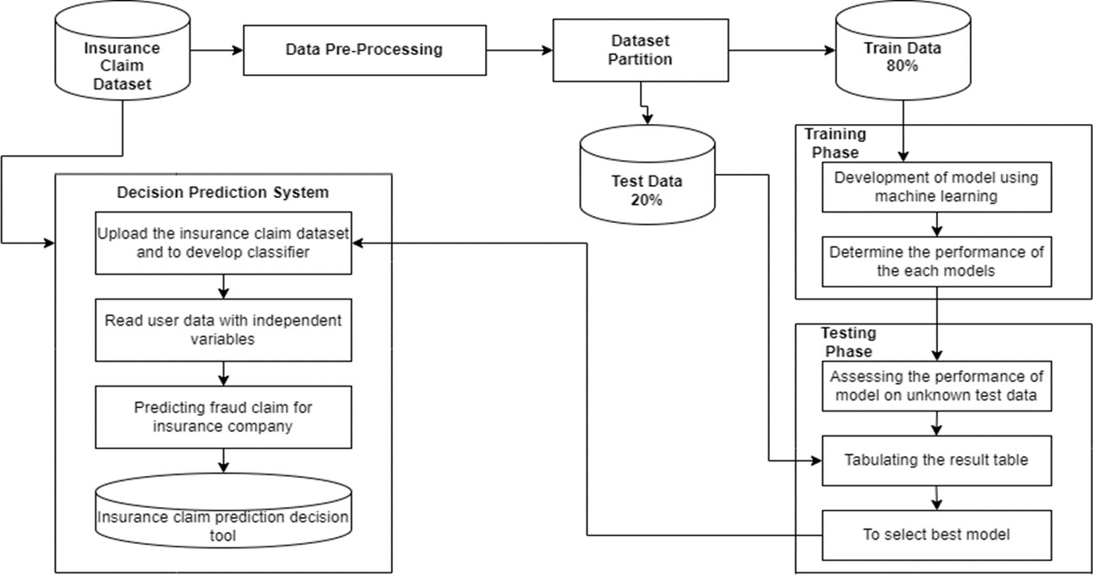
Architecture Diagram

Slide 18
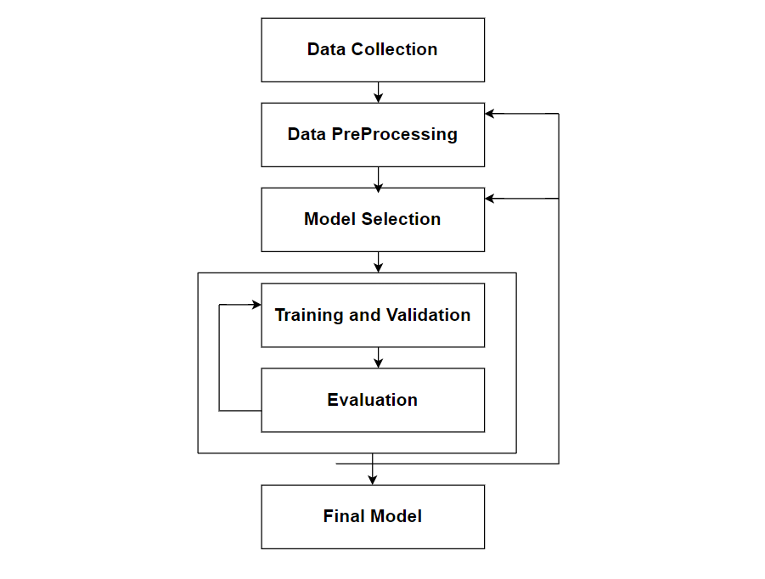
Data –Flow Diagram

Slide 19
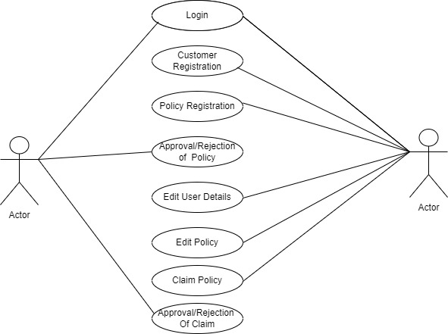
Use Case Diagram

Slide 20
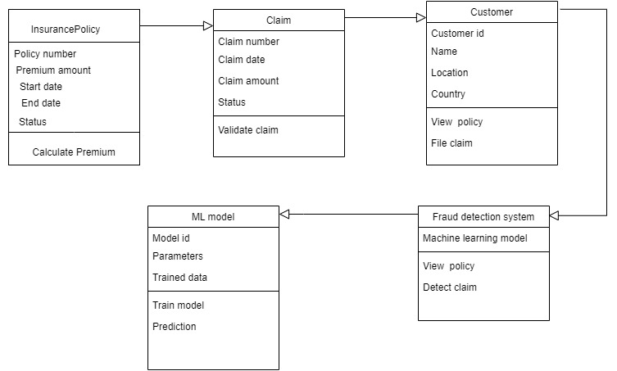
Class Diagram

Slide 21
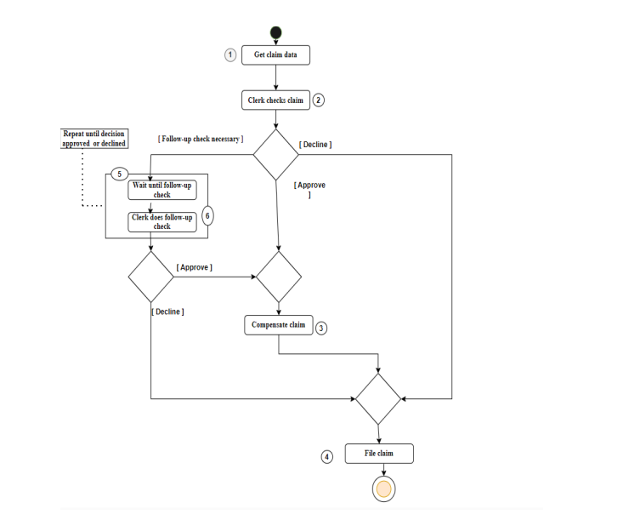
Activity Diagram

Slide 22
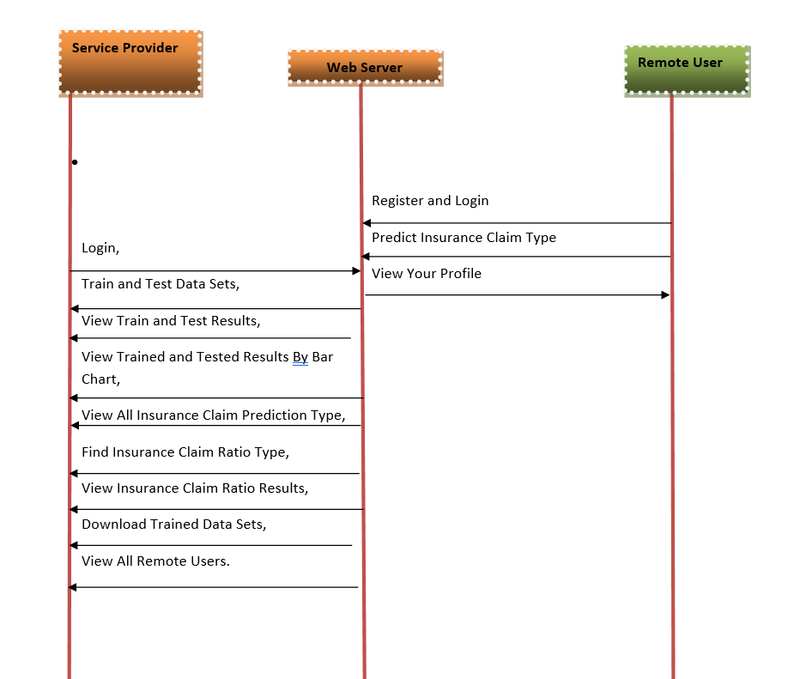
Sequence Diagram

Slide 23
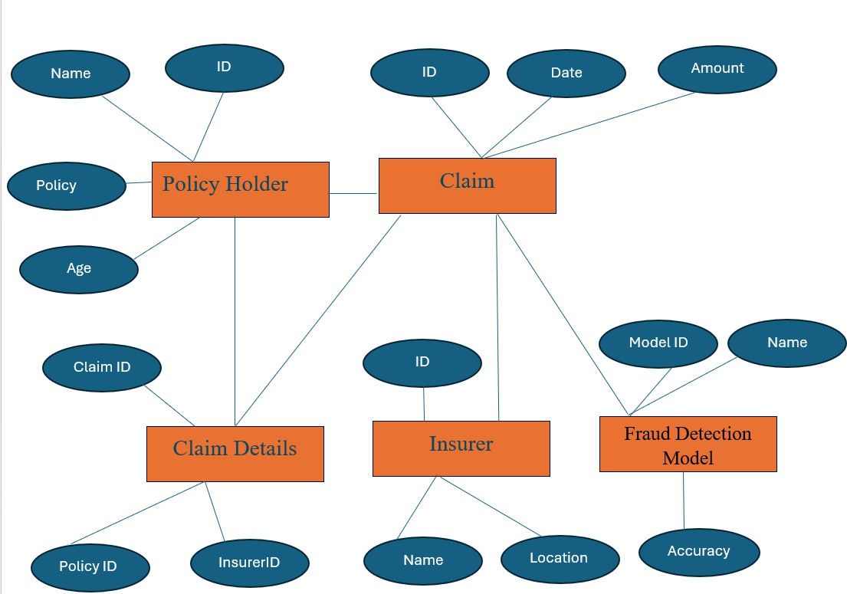
E-R Diagram

Slide 24
TESTING
UNIT TESTING
INTEGRATION TESTING
SYSTEM TESTING
Test results

Slide 25
UNIT TESTING
Unit testing involves the design of test cases that validate that the internal program logic is functioning properly, and that program inputs produce valid outputs. All decision branches and internal code flow should be validated. It is the testing of individual software units of the application . It is done after the completion of an individual unit before integration. This is a structural testing, that relies on knowledge of its construction and is invasive. Unit tests perform basic tests at component level and test a specific business process, application, and/or system configuration. Unit tests ensure that each unique path of a business process performs accurately to the documented specifications and contains clearly defined inputs and expected results.

Slide 26
INTEGRATION TESTING
Integration tests are designed to test integrated software components to determine if they actually run as one program. Testing is event driven and is more concerned with the basic outcome of screens or fields. Integration tests demonstrate that although the components were individually satisfaction, as shown by successfully unit testing, the combination of components is correct and consistent. Integration testing is specifically aimed at exposing the problems that arise from the combination of components

Slide 27
SYSTEM TESTING
System testing ensures that the entire integrated software system meets requirements. It tests a configuration to ensure known and predictable results. An example of system testing is the configuration oriented system integration test. System testing is based on process descriptions and flows, emphasizing pre-driven process links and integration points.

Slide 28
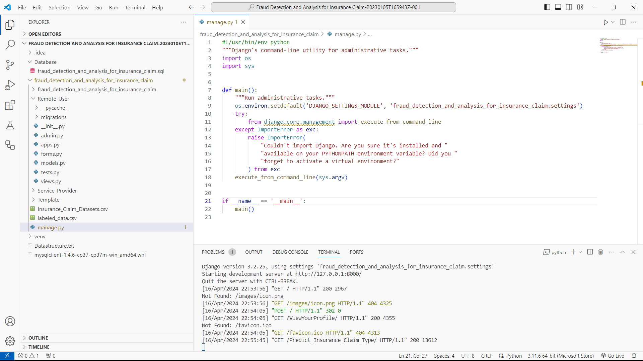
Test Results

Slide 29
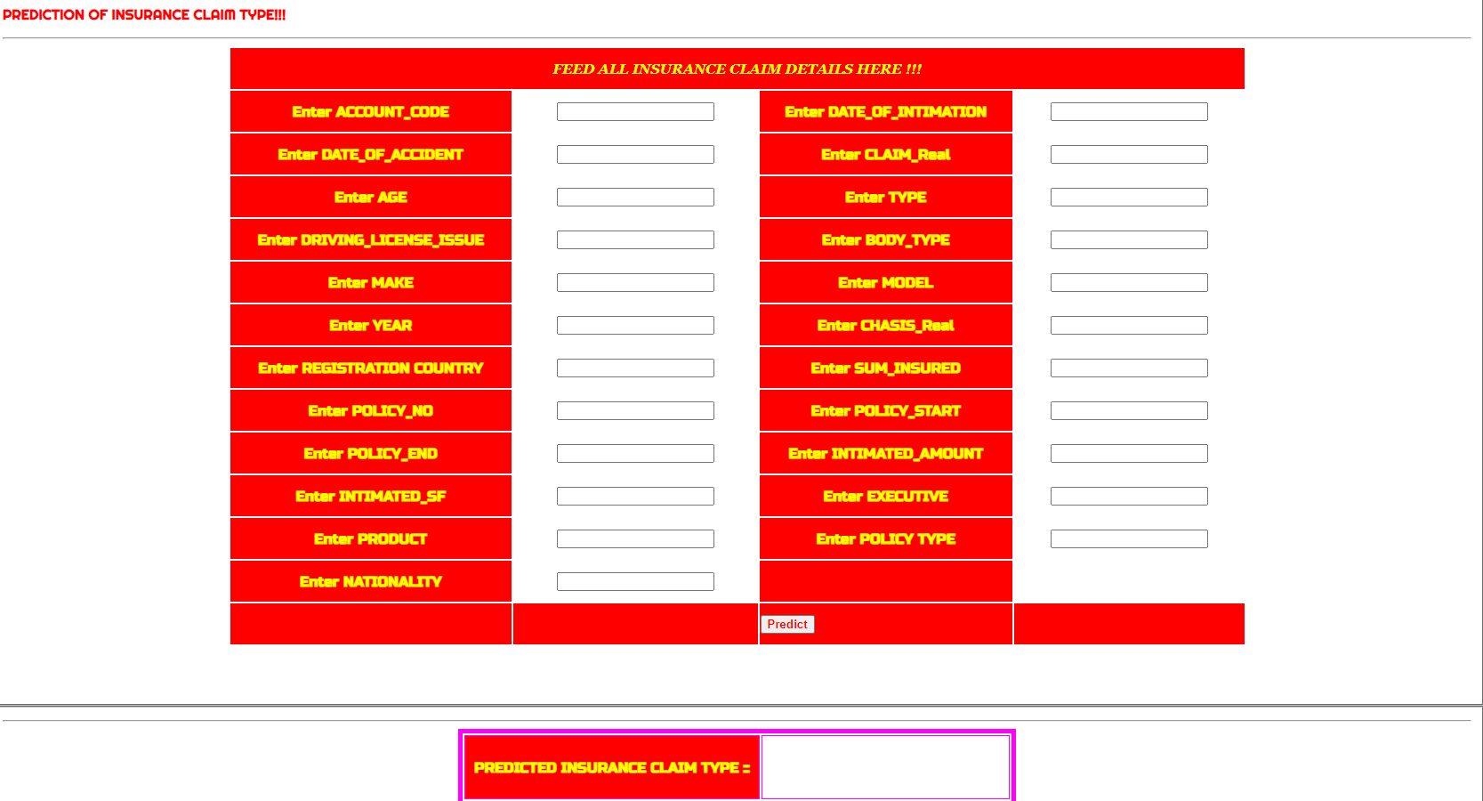
INPUT

Slide 30
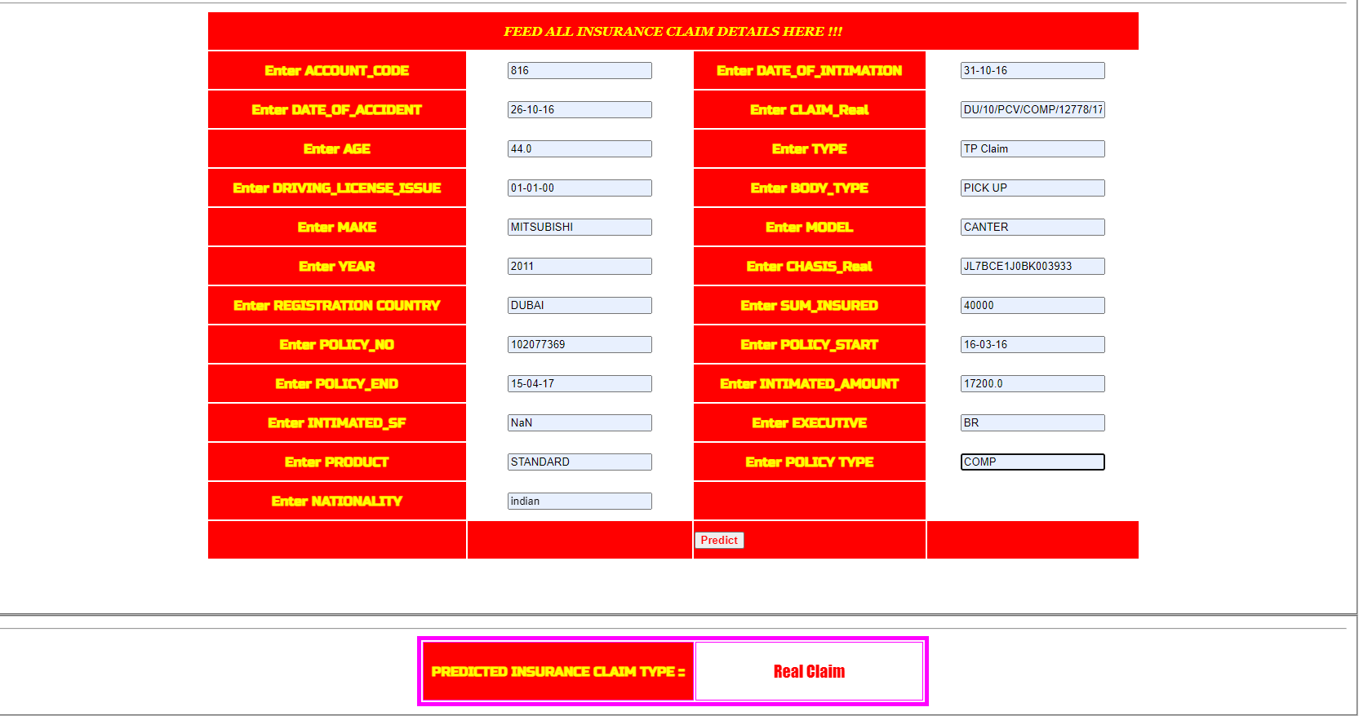
OUTPUT

Slide 31
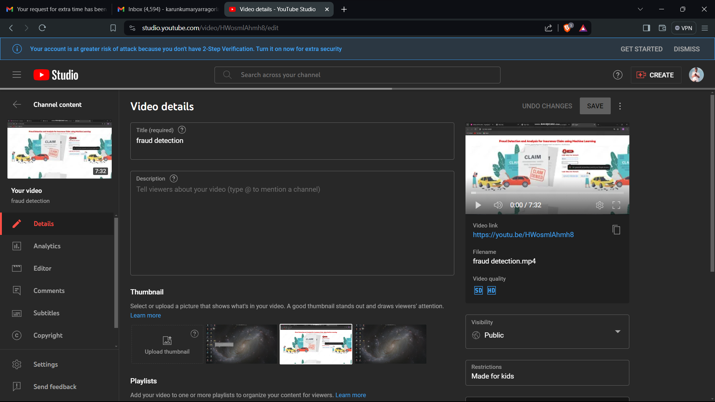
DEMO VIDEO

Slide 32
CONCLUSION
The machine learning models that square measure mentioned which square measure applied on these datasets were able to determine most of the fallacious cases with low false positive rate which suggests with cheap exactness. Certain knowledge sets had severe challenges around data quality, resulting in comparatively poor levels of prediction. Given inherent characteristics of varied datasets, it would not be sensible to outline optimum algorithmic techniques or use feature engineering process for a lot of higher performance. The models would then be used for specific business context and user priorities. This helps loss management units to specialize in a replacement fraud situations and then guaranteeing that models square measure adapting to spot them. However, it might be cheap to counsel that supported the model performance on back-testing and talent to spot new frauds, the set of models work the cheap suite to use within the space of the insurance claims fraud detection.

Slide 33
Future Enhancements
Future enhancements for fraud detection and analysis in insurance claims using classification algorithms involve a multifaceted approach. This includes advanced feature engineering to capture nuanced indicators of fraud, ensemble learning techniques to combine the strengths of multiple models, and the integration of anomaly detection methods to identify irregular patterns. Continuous model improvement ensures adaptability to evolving fraud tactics, fostering a proactive and robust fraud detection framework in the insurance industry.

Slide 34
Web references/video links
https://youtu.be/HWosmlAhmh8?si=OTxPTkJolLWASp_s

Slide 35
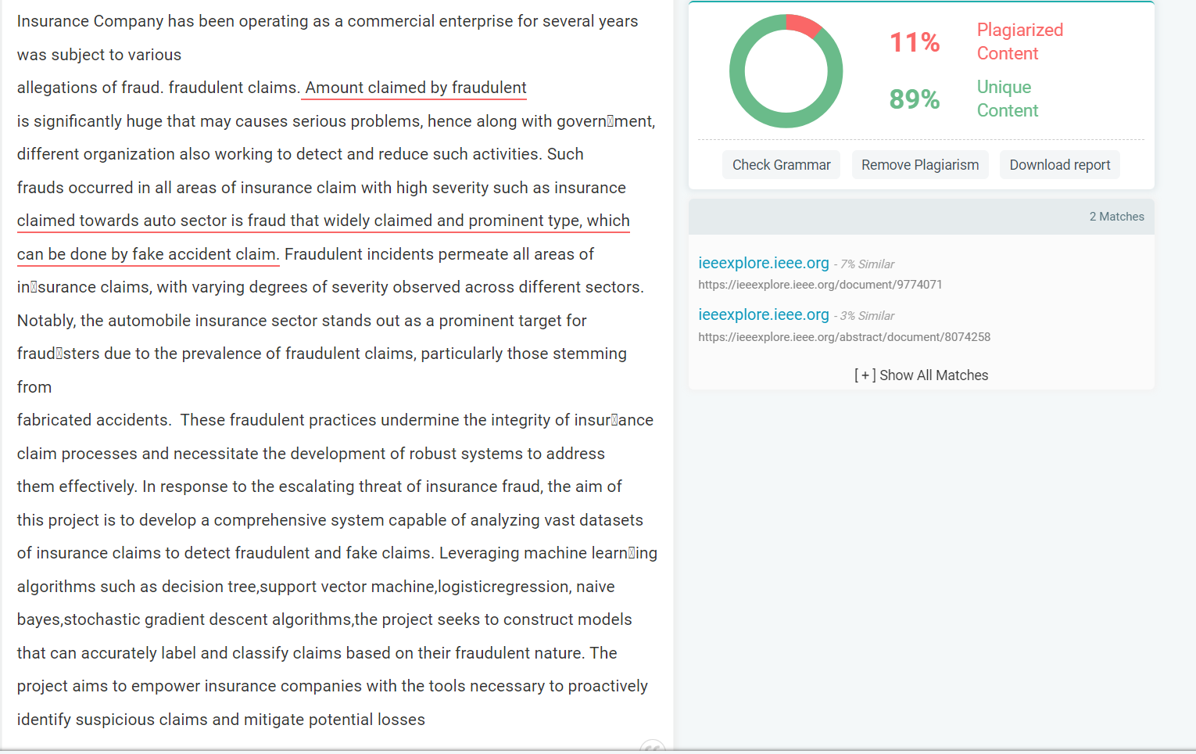
Plagiarism Report of PPT

Slide 36
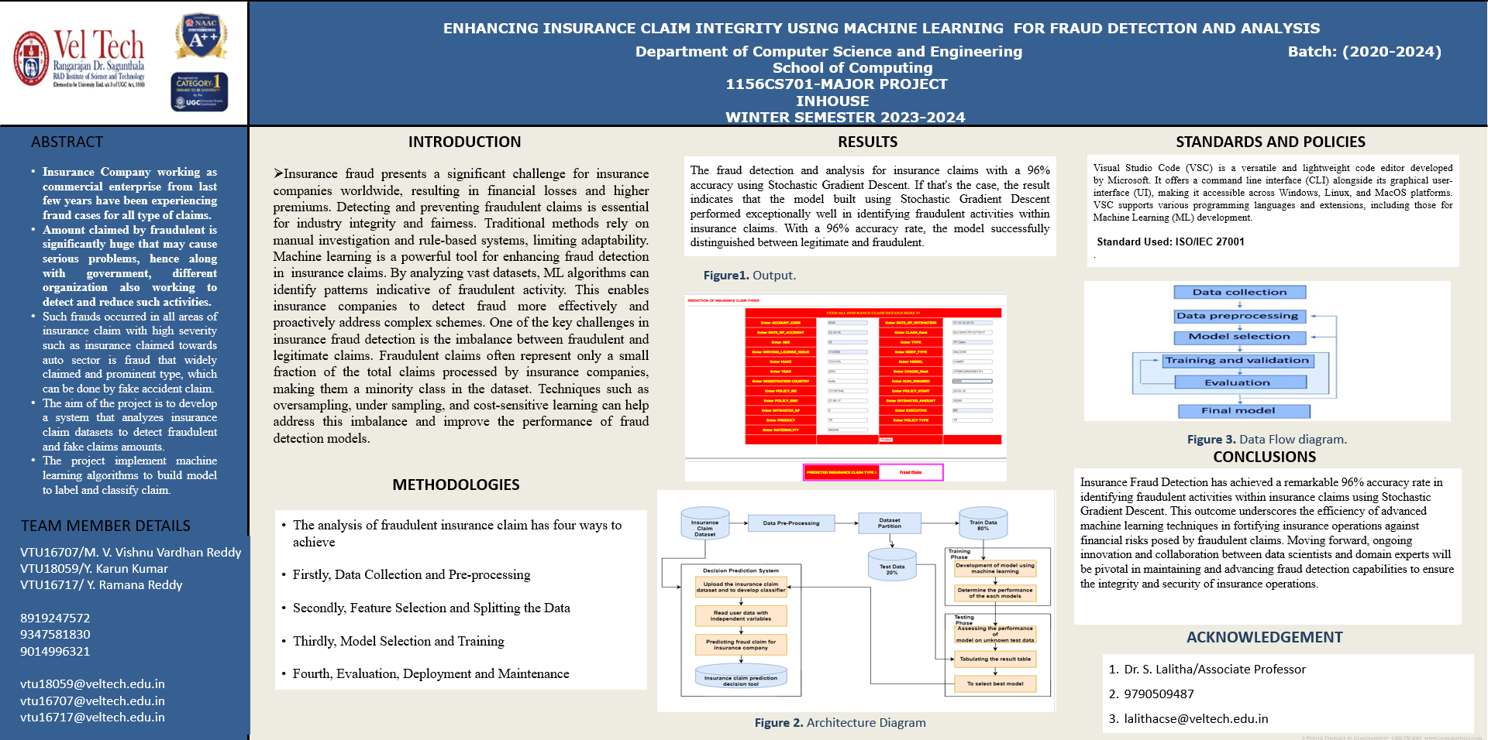
Poster Presentation

Slide 37
GitHub Link
(Project Execution Files)

Slide 38
REFERENCES
[1] Adedayo, F. Adedotun, Oluwaseun A. Odusanya, Olumide S. Adesina, J.A.“Adeyiga, Hilary I. Okagbue, and O. Oyewole.(2022). ”Prediction of AutomobileInsurance Fraud Claims Using Machine Learning.” Journal of Insurance Analytics, vol. 6, no. 2, pp. 87-102.
[2]Caruana, M. A., Grech, L., “Automobile Insurance Fraud Detection,(2022).”Journal of Insurance Fraud Detection, vol. 12, no. 3, pp. 87-104.
[3] Elsevier. (2022). Insurance Fraud Detection: Evidence from Artificial Intelligence and Machine Learning. Journal of Insurance Analytics, vol.7,no.3, pp.210-225.

Slide 39
REFERENCES(as per IEEE format only)
[4] Kapadiya, Khyati, Usha Patel, Rajesh Gupta,(2023). An Analysis, Architecture and Future Prospects.” Journal of Healthcare Engineering, vol.45,no.5, pp. 1-15
[5] Mark Anthony, and Liam Grech.(2022).“Automobile Insurance Fraud Detec-tion.” Journal of Fraud Detection and Prevention, vol. 9, no. 4, pp.301-315..
[6] Mary, A. Jenita, and S. P. Angelin Claret.(2022). “Analytical Study on Fraud Detection in Healthcare Insurance Claim Data Using Machine Learning Classifiers.” Journal of Healthcare Analytics, vol. 8, no. 2, pp. 145- 162.
[7] Mary Arockiam, Jenita, and Seraphim Pushpanathan Angelin Claret.(2023).“Detection Systems in Healthcare Insurance Industry.” Journal of Healthcare Informatics Research, vol. 12, no. 3, pp. 211-226.

Slide 40
REFERENCES
[8] Nabrawi, E., Alanazi, A.,(2023). “Fraud Detection in Healthcare Insurance Claims Using Machine Learning,” Journal of Healthcare Analytics, vol. 7, no. 2, pp. 45-60.
[9] Severino, M. K., Peng, Y. (2021). “Empirical evidence using real-world micro data”. Journal of Insurance Analytics, vol. 5, no. 1, 2021, pp. 45-58.
[10] Rima Kaafarania, Leila Ismailb,c,d, and Oussama Zahwea,(2023). “An Adaptive Decision-Making Approach for Better Selection of Blockchain Platform forHealth Insurance” International Journal of Information Management, vol. 45, no. 3, pp. 256-268.

Slide 41
THANK YOU

